Slide 1
The Future Ready CPA
Are You Ready for the Challenge?
Thomas R. Gawne, CPA

Slide 2

The Future Ready CPA
Are You Ready for the Challenge?

Slide 3
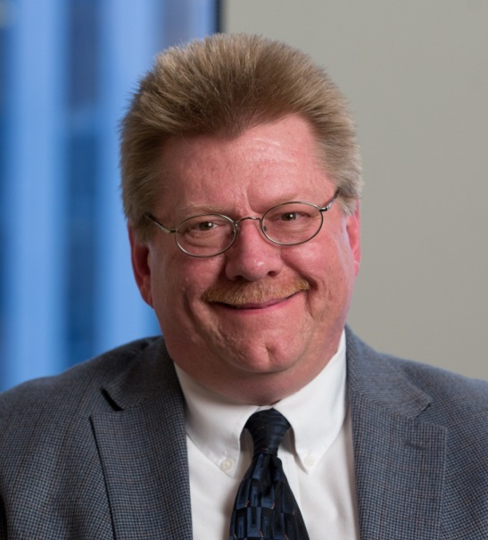
Thomas R. Gawne, CPA
Professional Services Systems Engineer
  29 years in the tax and accounting technology sector
  Consultant, Facilitator and Presenter

Slide 4
Agenda
Start with Strategy
Disruption & CPA’s
Internet of Things
How to Identify Disruptive Technology
Notes:
Need to start w/ a strategy in mind.
Discuss what is the internet of things
How to identify disruptive technology to better identify which technologies are going to make a difference for our future and how to lead your clients and staff through the changing environment successfully.

Slide 5
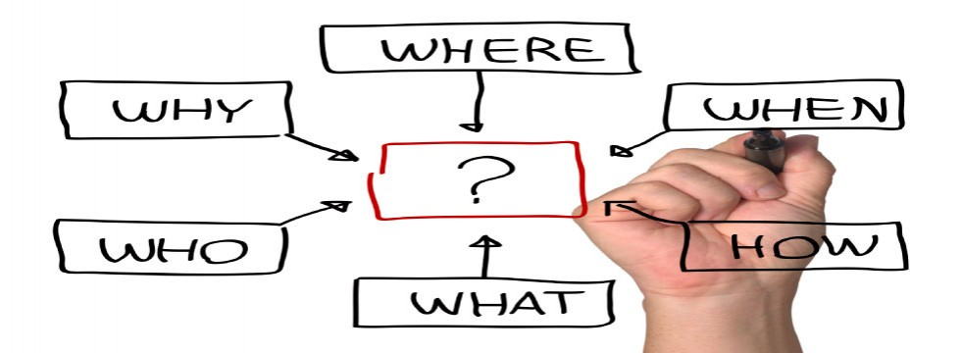
The Future
Ready CPA
Notes:
So to start w/ strategy let’s talk about why, where….of the future ready CPA?
We know the who – you.

Slide 6
CPA.com – Leading the Way
WHAT?
Harness the Power - Moore
Start with Why - Sinek
The Big Switch – Carr
Future Smart - Canton
WHEN?
WHY?
WHERE?
Notes:
To help with these questions CPA.com has been working w/ national business strategists and thought leaders.
Started with Moore --- technology provided automation
automation led to commoditization
commoditization forced differentiation
differentiation means specialization
specialization results in automation
Then to Sinik Golden Circle
Inspired leadership
Then Carr’s Big Switch Edison’s power grid was the Internet of the last century
Then Canton Measure the profession’s readiness
Over the past few years we have been spending considerable time understanding the shift in business & accounting services.
Two years ago we conducted primary research with Geoffrey Moore and produced a white paper outlining the major shifts occurring in client accounting and advanced our training and workshop programs to help firms build more successful practices.
This white paper has been leveraged by hundreds of firms and has become a foundation document for firms entering this space. It helps them understand how this practice area has evolved over the past 20 years.
Last year we worked with Simon Sinek on helping firms better define their purpose and address the change management issues inside a firm.
And this year we are working with Nicolas Carr to build perspective on where we are in this major technology shift.

Slide 7
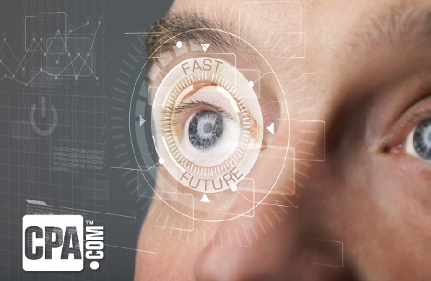
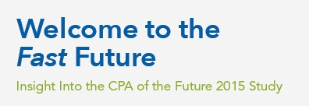
Are CPA’s
Future Ready?
Notes:
to help propel the profession forward we needed to get a gauge on where CPA’s were in their future readiness and here is what we found.

Slide 8

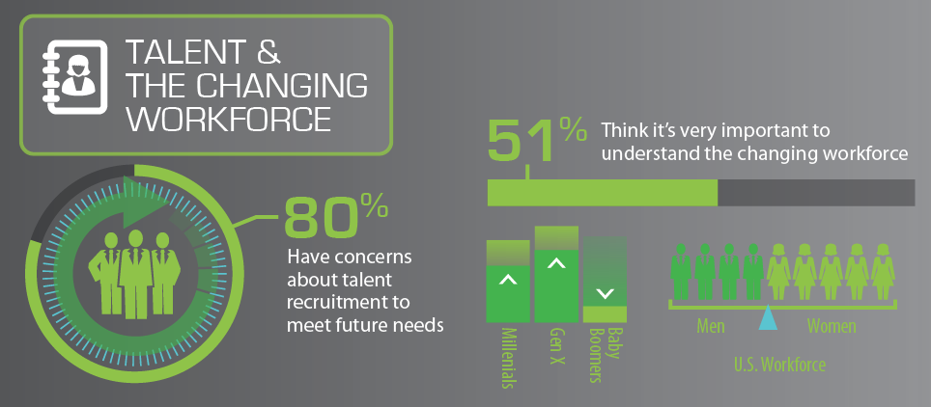
Notes:
When we look at the future readiness of the profession (which is a study done by CPA.com and Dr. Canton) we found the profession identifies the significance of globalization and your responsibilities to clients.

Slide 9
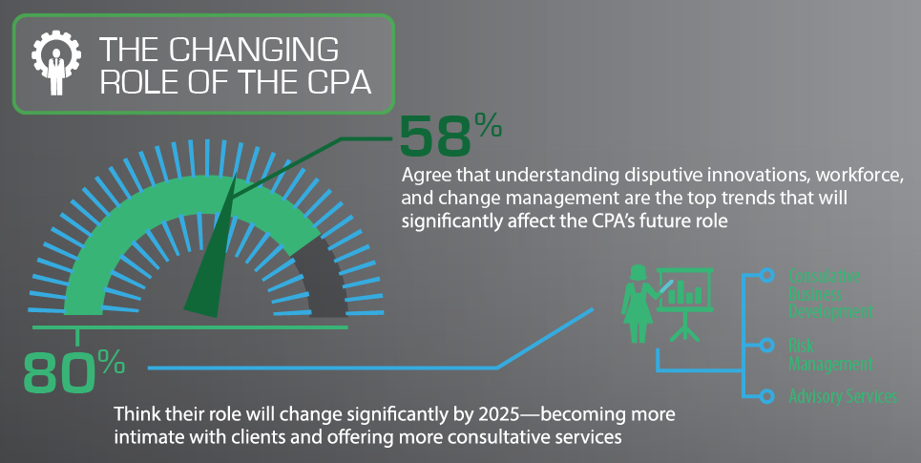
Notes:
When we look at the future readiness of the profession (which is a study done by CPA.com and Dr. Canton) we found the profession identifies the significance of globalization and your responsibilities to clients.

Slide 10
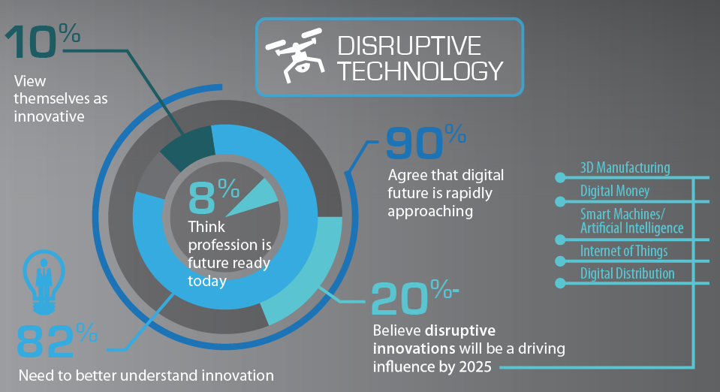
Notes:
When we look at the future readiness of the profession (which is a study done by CPA.com and Dr. Canton) we found the profession identifies the significance of globalization and your responsibilities to clients.

Slide 11
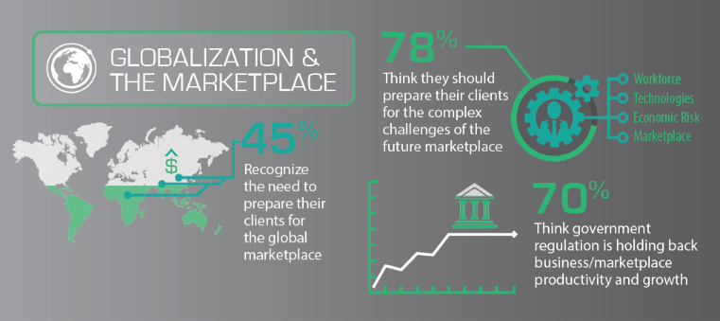
Notes:
When we look at the future readiness of the profession (which is a study done by CPA.com and Dr. Canton) we found the profession identifies the significance of globalization and your responsibilities to clients.

Slide 12
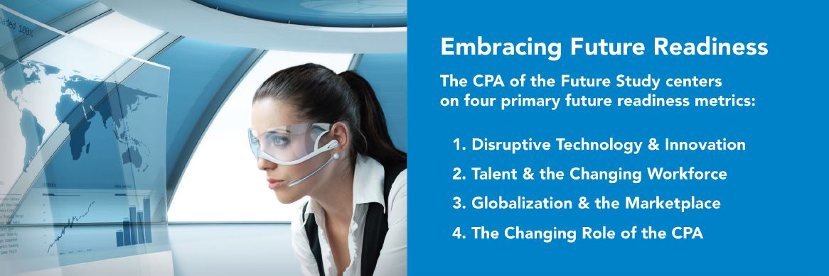
Notes:
The results boiled down to 4 primary metrics to consider when working on your future readiness
(list the 4 on the slide)
So what do we do with this information?

Slide 13
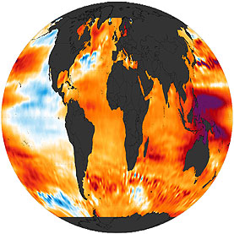

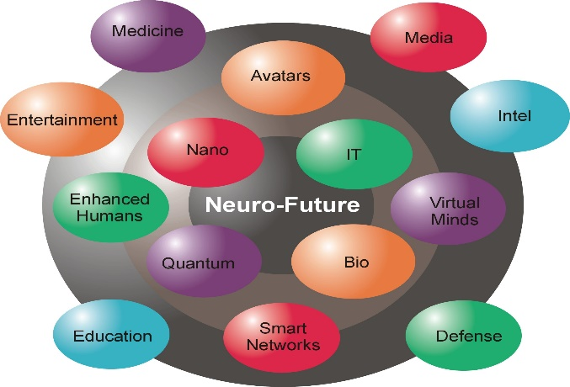
The Path Forward: CPA’s
1. Understand emerging innovation faster
2. Create a competitive talent strategy
3. Embrace globalization opportunities
4. Get in synch with the marketplace trends that will shape future markets
Notes:
Turning that into action we need to….
– easy to say – “Understand emerging innovation faster” but how do we do it? We will talk about some concepts to consider.
Create competitive talent
Embrace globalization – perhaps that means you specialize in it, you develop a strategy to support clients going global, you support their native language…
Get in synch – for you as the accounting profession, but also the niches you serve! Hard to stay abreast of all things happening which is why verticaling is being so key for successful practices for the future. Clients expect depth of knowledge, and to have the depth and breadth of every industry is becoming near impossible as we continue into the future.

Slide 14
Disruption & CPAs
Notes:
Lets start w/ the disruption
If we have to understand innovation faster then lets start w/ some key concepts.

Slide 15
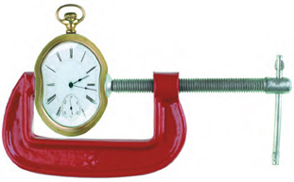
Templosion
“the implosion of everything into compressed time”
Tem·plo·sion [Tem-sploh-zhuhn] Noun

Slide 16
“It’s a Templosion”
“I like Tom Hood’s VUCA term to define the paradox. ‘Rapid, short-term change and long-term leadership ideas and goals simply don’t mesh well.’”
Hubert Glover,
Author: The Making of the Twenty-First-Century Leader
“It’s a VUCA world – Volatile, Uncertain, Complex, and Ambiguous … the answer to rapid changes and hyper-competition is a bold vision and core value’s; maintaining values that don’t change while constantly re-inventing the shorter term strategy.”
Tom Hood, CPA.CITP,
President & CEO, Maryland CPA Society

Slide 17
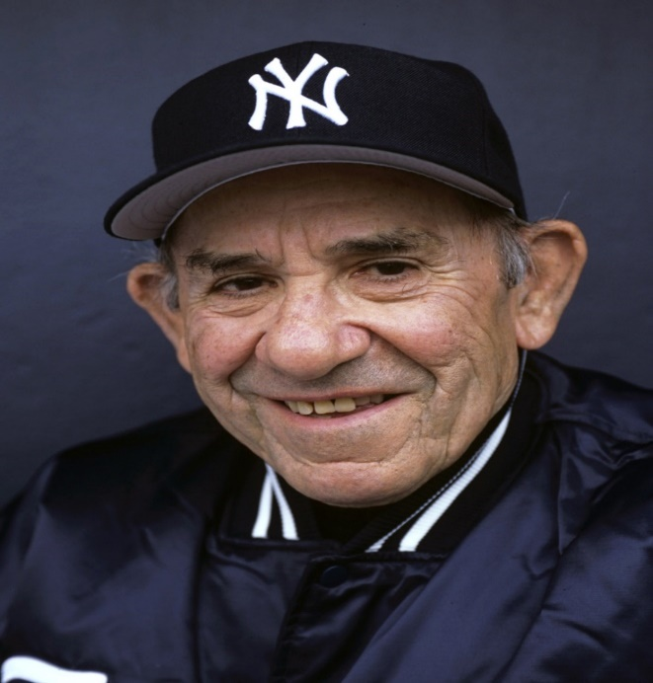
“It's tough to make predictions, especially about the future.”
A Note On Predictions
- Yogi Berra

Slide 18
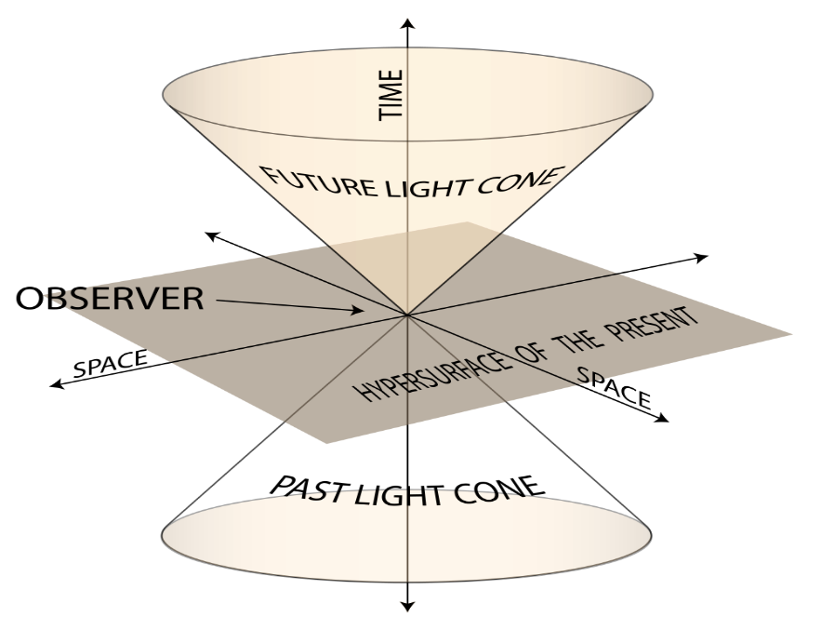
Our Near Term View is Always Unclear
“Inside the Tornado”
“Tipping Point”
“Crossing the Chasm”
Current Vantage Point
Notes:
5 months to 3 yrs hard to project, gets fuzzy.

Slide 19
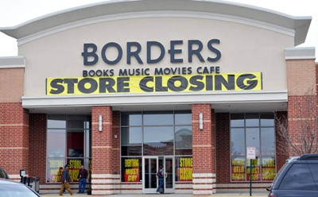
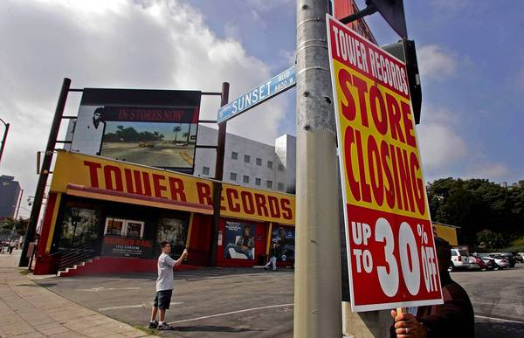


Disintermediation

Slide 20
Disintermediation
Removing the middleman -- a popular buzzword used to describe how Internet-based businesses are using cloud and mobile technologies to reach customers.
These companies provide products and services cheaper and faster.
These technologies are revolutionizing the way products and services are bought and sold, and disintermediation is the driving force behind this revolution.
Notes:
So what does this have to do w/ accounting. There is a lot of automation that is taking place that is really changing the services of accounting firms. More people feel empowered to do the work on their own, free e-filing of returns through govt, etc. So keeping this in mind is important as we think about emerging technologies impact.

Slide 21
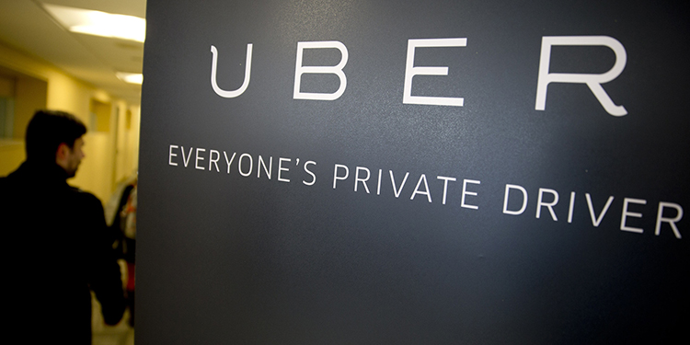

The Latest In Disintermediation
Notes:
And if you were thinking it was primarily goods like books and music, Uber is an example of a service. This is the latest and now buying fleets of self driving cars.
The great thing is you as CPA’s have knowledge and advice the technology can’t automate, but most firms have not adjusted their service offerings to be immune to disintermediation.

Slide 22
“It’s a VUCA world – Volatile, Uncertain, Complex, and Ambiguous … the answer to rapid changes and hyper-competition is a bold vision and core value’s; maintaining values that don’t change while constantly re-inventing the shorter term strategy.”
Tom Hood, CPA.CITP,
President & CEO, Maryland CPA Society
Notes:
The key is to remember this quote. This is what we talked about w/ the WHY! The what and how will change.

Slide 23
The Internet
Of Things
Notes:
An emerging technology is the IoT – it is changing how we live, operate and expectations we have.

Slide 24


What is…IOT?
(a.k.a., IOE)
Notes:
The Internet of Things (IoT) is a scenario in which objects, animals or people are provided with unique identifiers and the ability to transfer data over a network without requiring human-to-human or human-to-computer interaction.
The Internet of Things (IoT) is the network of physical objects or "things" embedded with electronics, software, sensors and connectivity to enable it to achieve greater value and service by exchanging data with the manufacturer, operator and/or other connected devices. Each thing is uniquely identifiable through its embedded computing system but is able to interoperate within the existing Internet infrastructure.

Slide 25
A Few Concepts . . .
*”A computing concept that describes a future where everyday physical objects will be connected to the Internet and be able to identify themselves to other devices.” – techopedia.com
*”A proposed development of the Internet in which everyday objects have network connectivity, allowing them to send and receive data.” – Oxford Dictionary
*”The Internet Of Things will make many of the familiar devices and objects in our lives — from door locks to toll booths to refrigerators — suddenly Internet-connected, smartphone-accessible, and responsive.” – Business Insider

Slide 26
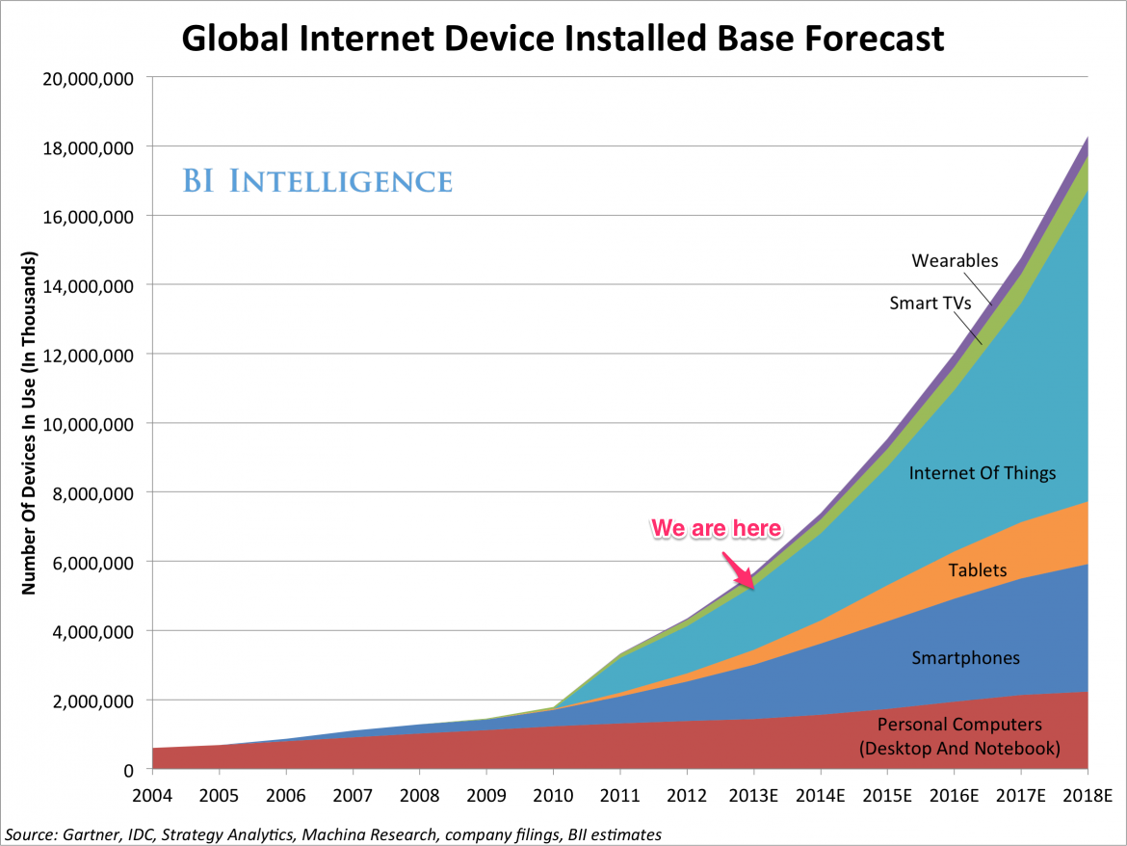
The Internet of Things
Will Soon
Dwarf the Rest
of the Internet

Slide 27
IFTTT Recipes
Channels
Triggers
Actions
Ingredients

Slide 28
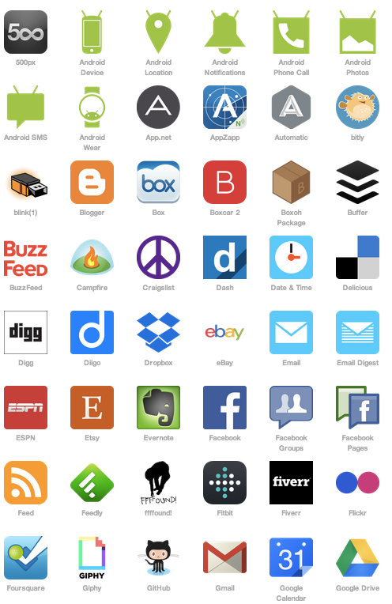
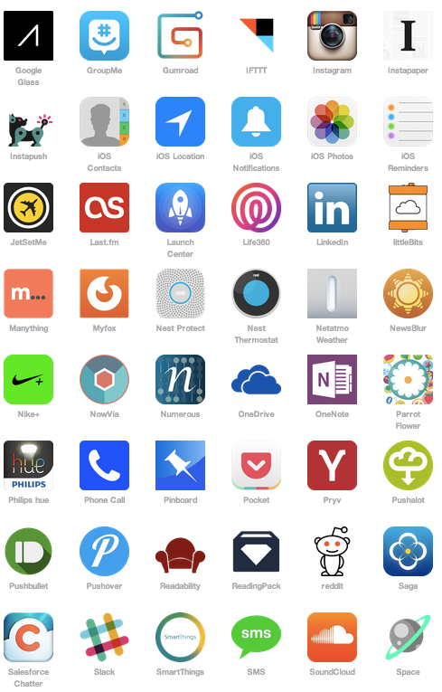
Channels
Hundreds of channels!
Notes:
Look at the things we can connect.

Slide 29
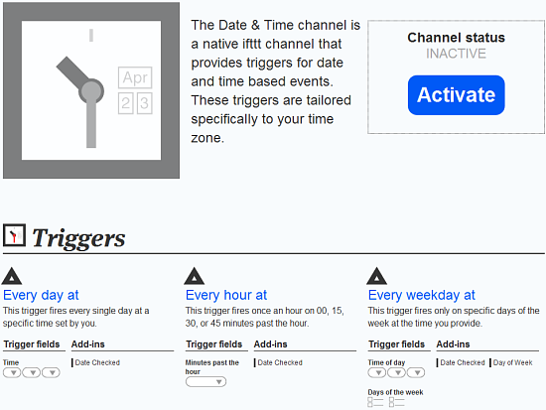
Triggers
If this….
…based on
the channel

Slide 30

Actions
This recipe uses the geo-location function of my smart phone to record every visit to the gym.

Slide 31
Ingredients
Pieces of Data From a Trigger = Ingredients
For example, the ingredients of an email trigger could be:
Subject
Body
Attachment
Received Date
Sender

Slide 32
10 Interesting Uses
Monitor you or your competitors’ TripAdvisor (or Yelp, etc.) reviews
Mute your phone when you have a meeting on your calendar
Your phone switches to vibrate when you walk into your office building
Record on your calendar or spreadsheet when you get to and leave work
Text your wife/husband when you leave work
Get an alert when your (or your clients’) website goes down
Receive a text when someone comments on your website
Get an alert when a certain person or certain people email you
Flash your lights when it rains
Wish customers/colleagues a Happy Birthday on Facebook
Notes:
Some of these may be of interest to your clients, but look at how this can help with your own team. When thinking of being future ready we have to think about the work environment for staff as well. In my consulting days I saw the frustration of staff in firms that didn’t use the technology or put systems in place that allowed the use of technology. They lost passion for what they were doing, got disenchanted with bringing ideas to the leadership. And this is all key for the future success of your firm. You need the new ideas and those working on the front line w/ clients and the systems as well.

Slide 33
What are the Possibilities when IoT Combines with Cloud-based Accounting?
Notes:
Any ideas? Something to be thinking about as you are looking to the future.

Slide 34






Peer Lending
Technology Is the Easy Part
Technology Executives
Loans being funded @ > $250M / month
Interest paid to investors: ~$500M to date
Non-Profit
> 1 million lenders
> $500,000,000 in loans / 99.01% Repayment rate
Technology & baking
Direct ties to cloud-based accounting platforms
Friends and Family
Regulation and litigation
Prosper (Wells Fargo execs)
>$1 billion in loan originations to date
Investment bankers
True “crowd-sourced” loan funding
Notes:
Lets look at an industry that very much touches you and your clients that the cloud facilitated – CrowdFunding

Slide 35
Crowdfunding Grows Up
2012’s JOBS Act, allows companies to raise up to $1 million in a 12-month period
From “accredited investors”
  Income over $200,000 (single) or $300,000 (joint) per year
  or net worth over $1 million
  An executive or director of the company
Under $100,000 requires two years of financial statements, certified by the principal executive, and its most recent tax return.
From $100,000 to $500,000 the statements must be reviewed by a CPA.
Over $500,000 must have audited statements

Slide 36
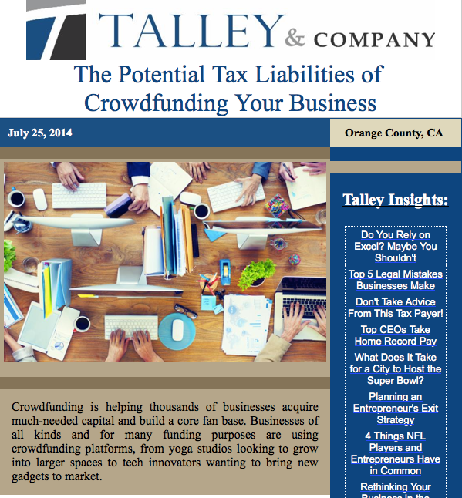
What It Means
Role of Banks?
Role of CPAs as Credit Advisors?
Financial Statements?
Benchmarking and analysis?
Personal investments?

Slide 37
How to Identify Disruptive Technologies
Notes:
Now we have talked about ones that exist how do you spot them coming? How do you keep the eye out and planning?

Slide 38

Transparency
Provider
Customer
Technology

Slide 39
8 Strong Indicators
Ratio of expenditures -- Legal to Tech
Governmental involvement
Excessive resistance --- mockery
Generational differentiation
Huge efficiencies
Protectionism
First or early mover(s) soon copied by others
Who benefits?
Notes:
The indicator when a tech is disruptive, not just shiny new and cool.

Slide 40
So What Changes After Uber as an Example?
Technology enables massive competition
Centralized regulation disappears
Fewer cars?
Fewer parking lots
Less congestion
Better safety
More productive time
Cost of trucking falls – logistics become cheaper
Fewer hotels?
Fewer full time jobs / more part time?
On demand delivery becomes standard – fewer bicycle messengers
Surge availability

Slide 41
Summary
The Fast Future
“Templosion”
Recognizing Disruptive Technologies
Significant Areas of Change
Think of how this will better prepare your business for success

Slide 42
Resources
CPA of the Future Study
  www.CPA.com/Future-Ready-CPA
Digital CPA Webcast – July 16, 2015
  “2 Emerging areas for Trusted Business Advisors”
  Registration opening shortly on CPA.com/Digital-CPA
“Accounting Services - Harnessing the Power of the Cloud”
  Dr. Geoffrey Moore
  http://www.cpa.com/whitepapers/accounting-services-harness-power-cloud
“Model of Success”
  Jeff Drew, Journal of Accountancy
  http://www.journalofaccountancy.com/issues/2015/apr/accounting-firm-business-models.html

Slide 43
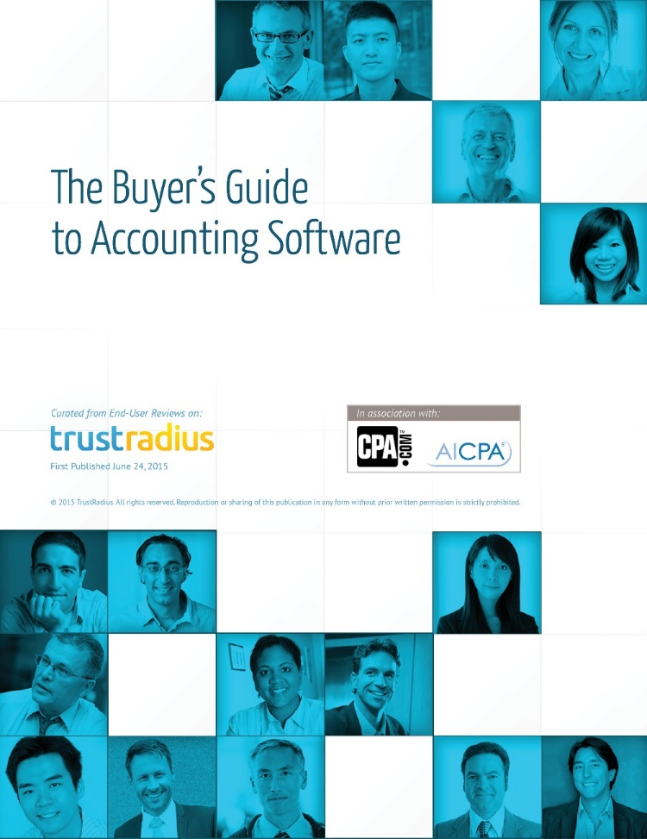

Your Feedback Needed
go.trustradius.com/cpa
Notes:
To further the research we work to bring to the profession CPA.com is working with TrustRadius to develop a buyers guide that evaluates the accounting software available today to give you a report on what products are a fit for various business models. If you are using accounting software we are looking for your input.

Slide 44
Join Us for Our Next Roadmap Workshop
Seats still available at our Chicago, IL Workshop!
August 11th & 12th
AICPA New York Office
1211 Avenue of the Americas, 19th Floor
New York, NY 10036

Slide 45




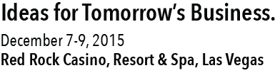
Notes:
Get more ideas and answers for the changing role of the CPA at Digital CPA Conference 2015. This year’s theme is focused on “Ideas for Tomorrow’s Business” with topics on innovation, developing your growth skills, evolving your pricing strategy, and more.

Slide 46
Questions?
Thank You!

Slide 47


@ThomasGawneCPA
#DigitalCPA
Notes:
We are centered on the power of smart business. This means a marriage of technology, strategy and regulatory requirements.

